Slide 1
CUSTOMER RETENTION PRESENTATION

Slide 2
TABLE OF CONTENTS
Introduction
Problem Statement and Understanding
Exploratory Data Analysis
Visualization
Steps and Assumptions
Data Analysis
Conclusion

Slide 3
Introduction
What is Customer Retention?
Customer retention is the practice of increasing a business’s repeat customer rate and extracting additional value from those customers. The goal of customer retention is to ensure a customer makes repeat purchases, is satisfied with a company’s services, and does not defect to a competitor.
Why is customer retention important?
Keeping your current customers happy is generally more cost-effective than acquiring first-time customers. According to the Harvard Business Review, acquiring a new customer can be more expensive than holding on to an existing one.

Slide 4
What are the benefits of Customer Retention?
Cost savings: Customer retention is generally more cost-effective than acquiring first-time customers
Positive word of mouth marketing: Loyal customers are more likely to tell their friends and family about your brand
A better bottom line: Increasing retention rates by just 5% can increase revenue by 25 per cent to 95 per cent

Slide 5
Problem Statement and Understanding
Problem Statement is that the Customer satisfaction has emerged as one of the most important factors that guarantee the success of online store; it has been posited as a key stimulant of purchase, repurchase intentions and customer loyalty. A comprehensive review of the literature, theories and models have been carried out to propose the models for customer activation and customer retention.
Five major factors that contributed to the success of an e-commerce store have been identified as: service quality, system quality, information quality, trust and net benefit. The research furthermore investigated the factors that influence the online customers repeat purchase intention. The combination of both utilitarian value and hedonistic values are needed to affect the repeat purchase intention (loyalty) positively. The data is collected from the Indian online shoppers. Results indicate the e-retail success factors, which are very much critical for customer satisfaction.

Slide 6
Problem Understanding is that the Customer satisfaction is one of the most important factors that guarantee the success of online store. Large number of customers are getting attracted towards the online shopping because e-stores offer them variety of services and products according to their preference. Some home-grown small e-retailers struggling because of competition. The decision making by these e-tailers becomes very much important in terms of customer activation and retention.  Hence, there is requirement of research on the dynamics of the Indian online retail industry and coming out with the models for successful development of this industry.
In this project, we have dataset of customer activation and retention. The primary objective of this study is to propose and analyse the online retail success model with emphasis on proving values to the customers.  This work proposes two online retail success models and analyse them with the data collected from online retail customers in India.

Slide 7
Exploratory Data Analysis
We have to imported the necessary libraries and loaded the entire dataset in our Jupyter Notebook.
Then we need to check the shape of given dataset and 269 row and 71 different columns present in the given dataset.
In given dataset no null values or missing values present in our dataset.
In given dataset all the columns have ‘object’ data type except the column representing the Pin Code which has ‘integer’ data type.

Slide 8
Visualization
Visualization allows business users to recognize relationships and patterns between the data and gives it greater meaning.
Different types of analysis: There are different types of analysis as mentioned below.
Univariate : In univariate analysis we will be using a single feature to analyse almost of its properties.
Bivariate : When we compare the data between exactly 2 features then it called bivariate analysis.
Multivariate: Comparing more than 2 variables is called as Multivariate analysis.

Slide 9
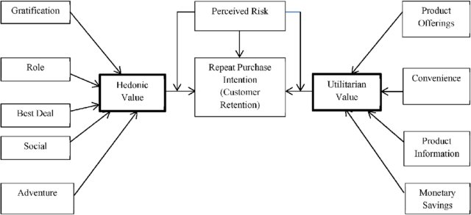
Steps and Assumptions
This model includes two values hedonic values and utilitarian values. Based on hedonic and utilitarian values we conclude customer’s retention model or customers purchase intention.
Customers Retention Model

Slide 10
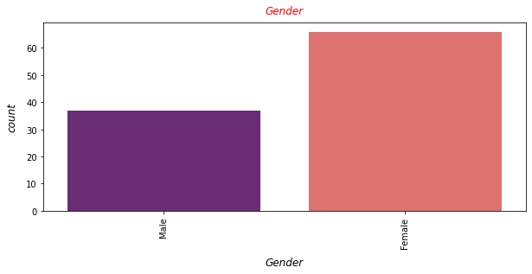
Data Analysis
As we can see that based on gender, we can easily say that the female customers are higher than the male customers

Slide 11
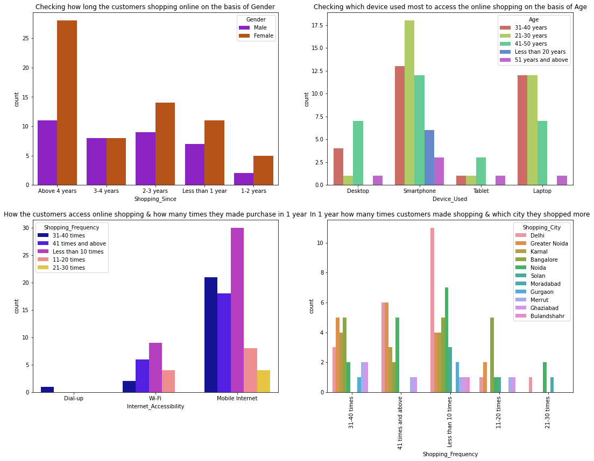
Female customers are more interested to buy products from the online shopping websites rather than male customers. As you can easily see in the above fig Female customers shopped online more as compared to male customers basis on the years. According to age factors most common Device Used is Smartphone as compared to another device. All age group have used smartphone. Customers are using their smartphone for shopping. Most of the customers used ecommerce websites less than 10 times in a year from the city Delhi to shop the products.

Slide 12
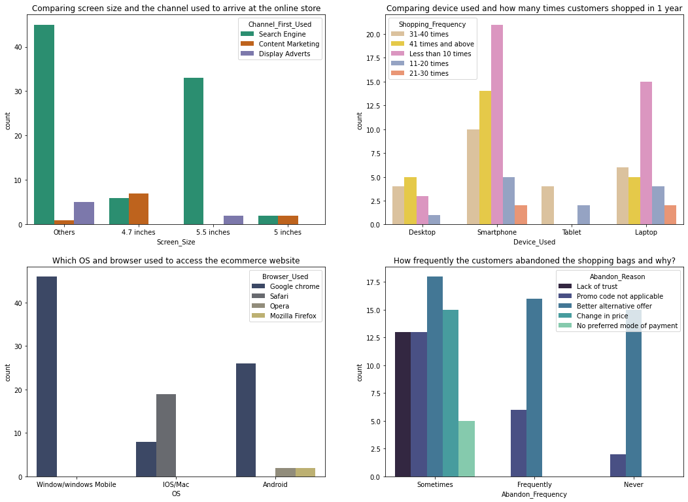
The customers with mobile screen size as Others have followed search engine channel to arrive at their favourite online store for the first time. Also, the customers who have their screen size 5.5 inches also used search engine channel to access the online shopping store. Most of the customers used Smartphones 31-40 times in a year to access the ecommerce websites to shop the products. Many customers having windows operating system in their device ran Google chrome to access the ecommerce shopping websites and some of the customers having IOS/Mac operating system used Google chrome as well as Safari to reach the online shopping store. Due to Lack of trust on the ecommerce websites, sometimes most of the customers abandoned the websites and some of the customers abandoned the shopping website due to the promo code not applicable.

Slide 13
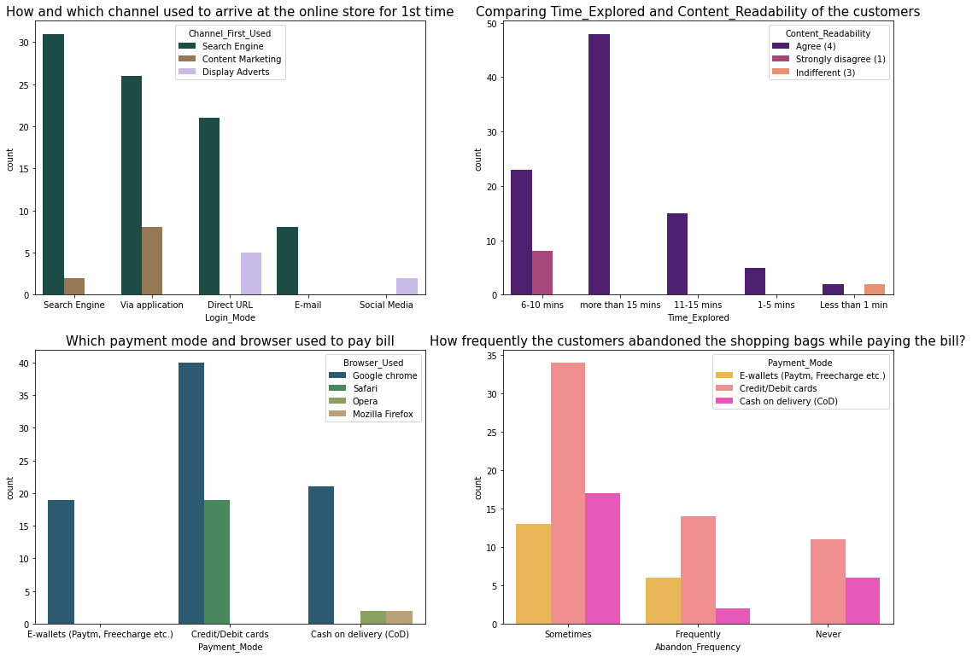
Most of the customers agreed that the content on the website is easy to read and understand also they explored more than 15 mins before making the purchase decision and some of the customers strongly disagreed that the content is not best, and they explored 6-10 mins before making the purchase decision. So, ecommerce websites should enable some images and it should contain clear structure, so that the customers can easily read and understand the content of the product. Most of the customers used google chrome to reach the websites and they preferred to pay their product price using Credit/Debit cards and only few of the customers used Safari browser to reach the e-retail websites.

Slide 14
Conclusion
Online retailers should zero in on the data quality and framework nature of the internet- based retail sites to upgrade consumer loyalty, which thus will prompt repurchase choice. Both the utilitarian and decadent qualities prompted consumer loyalty and extensively animate their repurchase aim, prompting reliability. Based upon the findings and analysis, the following assumptions are presented for the online sellers to make online shopping more popular, convenient, reliable and trustworthy. Transaction security and consumers data safety are principal concerns of online customers purchasing products or services online. Therefore, online vendors can assure their consumers' by offering personal information privacy, protection policy and guarantee for transaction security by improving their technological systems. Retailers should be careful about the annoying factors of online shopping such as being unable to access the website, inconsistencies in the items available online, mistakes in filling orders, and the hassle of returning goods. Online sellers can be more concerned about delivery times, delivery charge and product return policies.

